Slide 1


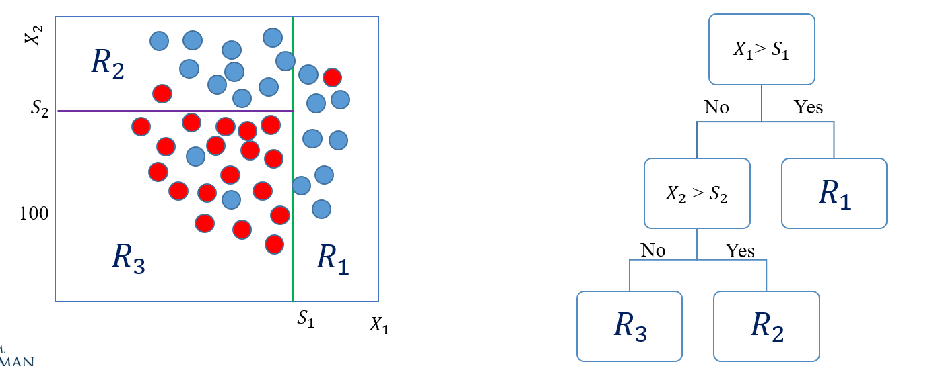
Module 9
Classification and Regression Trees
CART
Prof. Pedram Jahangiry

Slide 2


Class Modules
Module 1- Introduction to Deep Learning
Module 2- Setting up Machine Learning Environment
Module 3- Linear Regression (Econometrics approach)
Module 4- Machine Learning Fundamentals
Module 5- Linear Regression (Machine Learning approach)
Module 6- Penalized Regression (Ridge, LASSO, Elastic Net)
Module 7- Logistic Regression
Module 8- K-Nearest Neighbors (KNN)
Module 9- Classification and Regression Trees (CART)
Module 10- Bagging and Boosting
Module 11- Dimensionality Reduction (PCA)
Module 12- Clustering (KMeans – Hierarchical)

Slide 3
Road map
ML Algorithm
Supervised
Regression
Classification
Unsupervised
Dimensionality Reduction
Clustering
Principle Component Analysis (PCA)
K-Mean
Hierarchical
Linear / Polynomial
KNN
SVR
Tree-based Regression models
Logistic regression
KNN
SVC
Tree-based Classification models
Penalized regression
SVM
Decision Trees (DTs)
Bagging, Random Forest
Boosting
Notes:
CART are simple yet powerful ML algorithms popularized in 1984.
A large proportion of winning solutions in ML contests (especially on the Kaggle website) resort to improvements of simple trees.
For instance, the meta-study in bioinformatics by Olson et al. (2018) finds that boosted trees and random forests are the top 2 algorithms from a group of 13, excluding neural networks.
Applications in finance include using trees in portfolio allocation problems.

Slide 4

Topics
Part III
Pruning a tree
Hyperparameters
Part IV
Pros and Cons
Applications in Finance
Part I
Decision Trees Definitions
Decision Trees criteria
MSE
Error Rate
Gini Index
Entropy
Part II
Regression Trees
Classification Trees

Slide 5
Part I
Decision Trees definitions and criteria

Slide 6
Decision Trees Definitions
DTs are ML algorithms that progressively divide data sets into smaller data groups based on a descriptive feature, until they reach sets that are small enough to be described by some label.
DTs apply a top-down approach to data, trying to group and label observations that are similar.
Height> 6
Weight > 180
Female
Male
Male
Weight
$$R_{2}$$
180
No
Yes
$$R_{1}$$
100
$$R_{3}$$
$$R_{1}$$
No
Yes
4
5
6
Height
$$R_{3}$$
$$R_{2}$$
Notes:
This label can be qualitative (classification) or quantitative (regression).
Top down greedy recursive binary approach:
This process is recursive because it uses subsets of data resulting from prior splits. It is top-down because it begins at the root node of the tree, where all observations still belong to a single region, and then successively creates two new branches of the tree by adding one more split to the predictor space. It is greedy because the algorithm picks the best rule in the form of a feature-threshold combination based on the immediate impact on the objective function, rather than looking ahead and evaluating the loss several steps ahead.

Slide 7
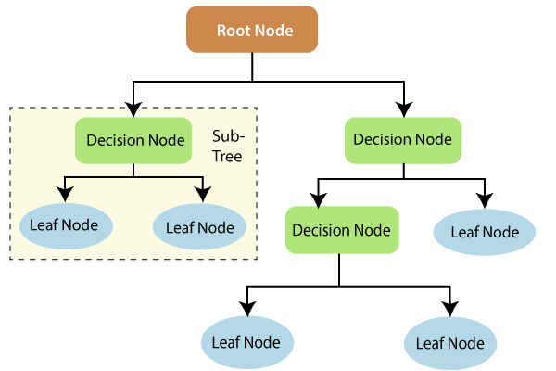
Decision Trees Definitions
When the target variable consists of real numbers: regression trees
When the target variable is categorical: classification trees
Terminology:
Root node
Splitting
Branch
Decision node (internal node)
Leaf node (terminal node)
Sub-tree
Depth (level)
Pruning
Notes:
Root Node: is the beginning of a tree
Splitting: Dividing a node into two or more sub-nodes based on if-else conditions.
Branch: the link between nodes
Decision Node: splits into further nodes
Leaf or Terminal Node: This is the end of the decision tree where it cannot be split into further sub-nodes.
Sub-Tree: A part of the entire decision tree is called a branch or sub-tree.
The depth of a decision tree is the length of the longest path from a root to a leaf.
Pruning: Removing a sub-node from the tree is called pruning.

Slide 8
Decision Trees Criteria
Which split adds the most information gain (minimum impurity)?
Regression trees: MSE
Classification trees:
Error rate
Entropy
Gini Index
Control how a Decision Tree decides to split the data
$$X_{2}$$
They all measure impurity
$$X_{1}$$
Notes:
We are trying to min something when deciding what feature to start with! What is that thing?
Information Gain is applied to quantify which feature provides maximal information about the classification based on the notion of entropy, i.e. by quantifying the size of uncertainty, disorder or impurity, in general, with the intention of decreasing the amount of entropy initiating from the top (root node) to bottom(leaves nodes).

Slide 9
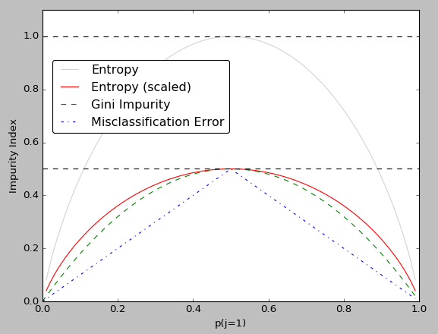
Decision Trees Criteria
Entropy: Measures the impurity or randomness (uncertainty) in the data points
Gini Index: Measure how often a randomly chosen element would be incorrectly labeled
For both Entropy and Gini, 0 expresses all the elements belong to a specified class (pure)
Different decision tree algorithms utilize different impurity metrics
$$entropy=− \sum_{j}{p_{j}\log_{2}{(p_{j})}}$$
$$Gini=1− \sum_{j}{p_{j}^{2}}$$
Notes:
P: Proportion of samples belongs to class j for a particular node.
In our previous example, at the root node, entropy and gini are if we chose the vertical split. If I use the vertical split, how often a randomly chosen element would be misclassified? 50% right? What do you think about the impurity? Maxed right?
Entropy: the maximum surprise in flipping a coin happens when p=0.5. in that point the Shannon entropy is 1 (we should use log base 2)
The method of the Gini Index is used by CART algorithms, in contrast to it, Information Gain is used in ID3, C4.5 algorithms.
An attribute with highest Information gain will tested/split first. Information Gain is the decrease in Entropy

Slide 10
Part II
Regression / Classification Trees!
How does a decision tree work?

Slide 11
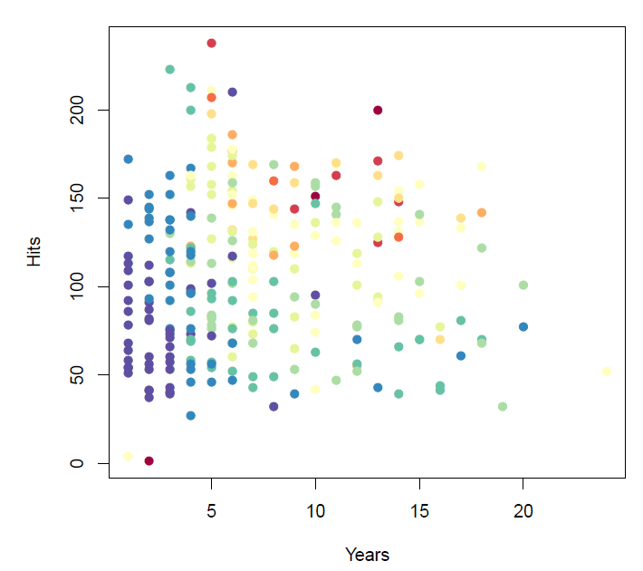
Regression Trees
Baseball Salary is color-coded from low (blue, green) to high (yellow, red)
DTs apply a top-down approach to data, trying to group and label observations that are similar.
The main questions in every decision-making process:
Which feature to start with?
Where to put the split (cut off)?
Notes:
Yes, using only the midpoint as the cut-off point can sometimes lead to suboptimal trees, especially when dealing with continuous features that have a wide range of values or when the data is noisy or imbalanced.
To address this issue, there are several techniques that can be used to determine the cut-off point for a feature:
Random cut-offs: Instead of using the midpoint, we can randomly select a value within the range of the feature as the cut-off point. This can help to prevent overfitting and can also be useful when there are multiple possible cut-off points that result in similar information gain.
Histogram-based methods: These methods involve sorting the data for each feature into bins or buckets based on their value and then selecting the cut-off point at the boundary between two adjacent bins that results in the maximum information gain. This can be more efficient than exhaustively searching all possible cut-off points.
Gradient-based methods: Gradient-based Optimal Splitting Strategy (GOSS) is a popular algorithm that uses gradient boosting to find the optimal cut-off point for each feature. The algorithm estimates the gain of each possible split by using a weighted sampling method to focus on the examples that are most difficult to classify.
In practice, the choice of method for determining the cut-off point depends on the characteristics of the data and the specific problem being solved. Some methods may be more effective than others for certain types of data or for certain decision tree algorithms.

Slide 12
Interpreting the results
Based on color-coded salary, it seems that years is the most important factor in determining salary.
For less experienced players, the number of hits seems irrelevant.
Among more experienced players thought, players with more hits tend to have higher salaries.
As one can see, the model is very easy to display, interpret and explain.

Slide 13
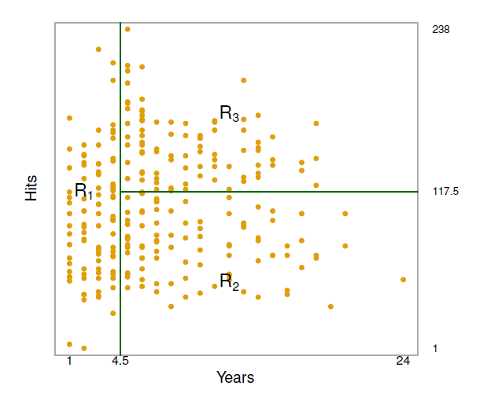
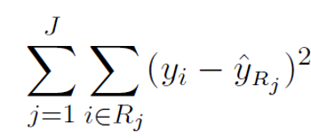
Tree building process
Divide the feature space into J distinct and non-overlapping regions.
For every observation that falls into the region $R_{j}$, we make the same prediction, which is simply the mean of the target values for the training observations in $R_{j}$.
The goal is to find rectangles $R_{1}, R_{2},…, R_{j}$that minimize the RSS:
Where ${\hat{y}}_{R_{j}}$ is the mean target for the training observations within the $j^{th}$ rectangle.
Notes:
In theory, the regions could have any shape! However, we choose to divide the feature space into rectangles or boxes for simplicity.

Slide 14
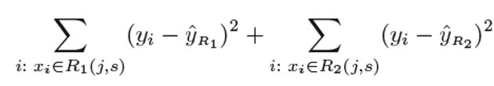
Tree building process: Recursive Binary Splitting
How does the algorithm select $X_{j}$ and the split$s$ ?
$X_{j}$ and $s$ are selected such that splitting the feature space into the regions $\{X|X_{j}<s\}$ and $\{X|X_{j}≥s\}$ leads to the largest possible reduction in RSS.
$R_{1}\left(j,s\right)= \left\{X | X_{j}<s\right\}$and $R_{2}\left(j,s\right)= \{X|X_{j}≥s\}$
Seeking for the value of $j$and $s$ that minimized the following equation:
The best split is made at that particular step, rather than looking ahead and picking a split that will lead to a better tree in some future step.
Notes:
Unfortunately, it is computationally infeasible to consider every possible partition of the feature space into J boxes. For this reason, we take a top-down, greedy approach that is known as recursive binary splitting. The approach is top-down because it begins at the top of the tree (at which point all observations belong to a single region) and then successively splits the predictor space; each split is indicated via two new branches further down on the tree. It is greedy because at each step of the tree-building process, the best split is made at that particular step, rather than looking ahead and picking a split that will lead to a better tree in some future step.
Finding the values of j and s that minimize (8.3) can be done quite quickly, especially when the number of features p is not too large.

Slide 15
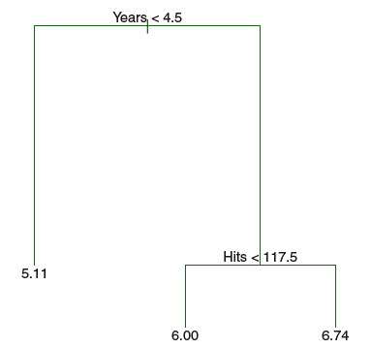
Tree building process: Recursive Binary Splitting
Next, the algorithm repeats the process, looking for the best feature and best split in order to split the data further to minimize the RSS within each of the resulting regions.
The process continues until a stopping criterion is reached; for instance, continues until no region contains more than a fixed number of observations.

Slide 16
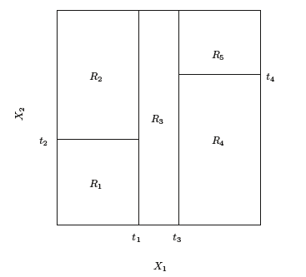
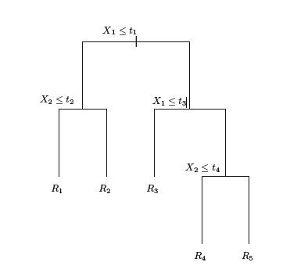
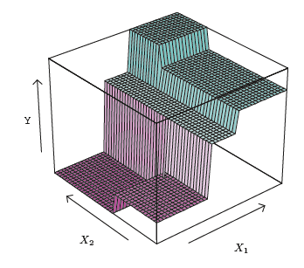
A Five-Region Example of Recursive Binary Splitting
The output of recursive binary splitting on a two-dimensional example
A tree corresponding to the partition in the left panel.
A perspective plot of the prediction surface corresponding to that tree.
Notes:
Our final function for f(x) is a piece-wise constant function.

Slide 17
Overfitting?

Slide 18
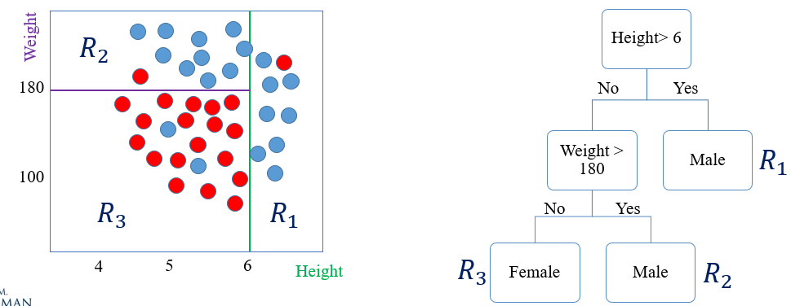
Classification Trees
Classification trees are very similar to regression trees, except that it is used to predict a qualitative response rather thana quantitative one.
The prediction of the algorithm at each terminal node will be the category with the majority of data points i.e., the most commonly occurring class.
Notes:
What are the outputs of classification trees? Can we have probabilities? Yes

Slide 19



Classification Trees (details)
Just as in the regression setting, the recursive binary splitting is used to grow a classification tree. However, instead of RSS we will be using one of the following impurity criteria:
Classification error rate:
Gini index:
Cross entropy:
${\hat{p}}_{mk}$ represents the proportion of training observations in the $m^{th}$ region from the $k^{th}$ class.
Classification error rate is not sufficiently sensitive to node purity and in practice either Gini or Cross entropy is preferred.
Notes:
we predict that each observation belongs to the most commonly occurring class of training observations in the region to which it belongs
the classification error rate is simply the fraction of the training observations in that region that do not belong to the most common class:
Gini is referred to purity index because it gives you the purity of the region. If p = 0 or 1 then the class is pure.
We have seen Gini index in econ. https://en.wikipedia.org/wiki/Gini_coefficient
You have a bag of marbles with 64 red marbles and 36 blue marbles. What is the value of the Gini Index for that bag? Gini Index = .64*(1-.64) + .36*(1-.36) = .4608
The value of cross entropy is Cross Entropy = -.64*ln(.64) - .36*ln(.36) = .6534
One can show that the entropy will take on a value near zero if the ˆpmk’s are all near zero or near one. Therefore, like the Gini index, the entropy will take on a small value if the mth node is pure

Slide 20
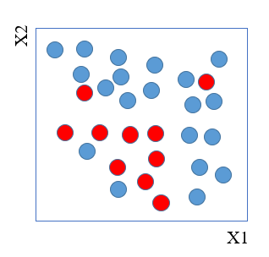
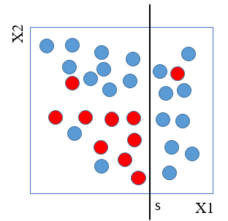
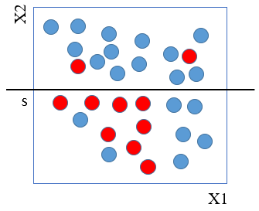
Decision Tree Metrics (Simple Example)
Node | $$Gini$$ $$1− \sum_{j}{p_{j}^{2}}$$ | $$Cross entropy$$ $$− \sum_{j}{p_{j}\log\left(p_{i}\right)}$$ | $$Error rate$$ $$1−\max\left(p_{i}\right)$$
Entire training data before split | $$\left\{1 – \left({\left(\frac{10}{30}\right)}^{2}+{\left(\frac{20}{30}\right)}^{2}\right) \right\}= 0.44$$ | $−\left\{\left(\frac{10}{30}\log{\frac{10}{30}}+\frac{20}{30}\log{\frac{20}{30}}\right)\right\}$ = 0.64 | $$1−\max\left\{\frac{10}{30},\frac{20}{30}\right\}=1−\frac{20}{30}=0.333$$
Root node: X1 > s | $\frac{20}{30}∗\left\{1 – \left({\left(\frac{9}{20}\right)}^{2}+{\left(\frac{11}{20}\right)}^{2}\right) \right\}$ + $\frac{10}{30}∗\left\{1 – \left({\left(\frac{1}{10}\right)}^{2}+{\left(\frac{9}{10}\right)}^{2}\right) \right\}=$ $$\frac{20}{30} ∗0.495+\frac{10}{30} ∗0.18=0.39$$ | $−\frac{20}{30}\left\{\left(\frac{9}{20}\log_{2}{\frac{9}{20}}+\frac{11}{20}\log_{2}{\frac{11}{20}}\right)\right\}$ + $−\frac{10}{30}\left\{\left(\frac{1}{10}\log_{2}{\frac{1}{10}}+\frac{9}{10}\log_{2}{\frac{9}{10}}\right)\right\}$ = $$\frac{20}{30} ∗0.69+\frac{10}{30} ∗0.325=0.57$$ | $$\frac{20}{30}\{1−\max\left(\frac{9}{20},\frac{11}{20}\right)\}+$$ $$\frac{10}{30}\{1−\max\left(\frac{1}{10},\frac{9}{10}\right)\}=$$ 0.333
Root node: X2 > s | $$\frac{15}{30}∗\left\{1 – \left({\left(\frac{2}{15}\right)}^{2}+{\left(\frac{13}{15}\right)}^{2}\right) \right\}\text{ +}$$ $$\frac{15}{30}∗\left\{1 – \left({\left(\frac{8}{15}\right)}^{2}+{\left(\frac{7}{15}\right)}^{2}\right) \right\}=$$ $$\frac{15}{30} ∗0.231+\frac{15}{30} ∗0.497=0.37$$ | $−\frac{15}{30}\left\{\left(\frac{2}{15}\log_{2}{\frac{2}{15}}+\frac{13}{15}\log_{2}{\frac{13}{15}}\right)\right\}$ + $−\frac{15}{30}\left\{\left(\frac{8}{15}\log_{2}{\frac{8}{15}}+\frac{7}{15}\log_{2}{\frac{7}{15}}\right)\right\}$ = $$\frac{15}{30} ∗0.39+\frac{15}{30} ∗0.69=0.54$$ | $$\frac{15}{30}\{1−\max\left(\frac{2}{15},\frac{13}{15}\right)\}+$$ $$\frac{15}{30}\{1−\max\left(\frac{8}{15},\frac{7}{15}\right)\}=$$ 0.3
Notes:
P is the probability of class j in region m.
We have 10 red circles and 20 blues
Before making the split, ask which split is going to do a better job? Vertical or horizontal? It is a close call right?
After making the first split, ask a question. Do you think the impurity index is higher or lower for the left region? Why?
Information gain for entropy is more sensitive than Gini.
What is the first split? Vertical!

Slide 21
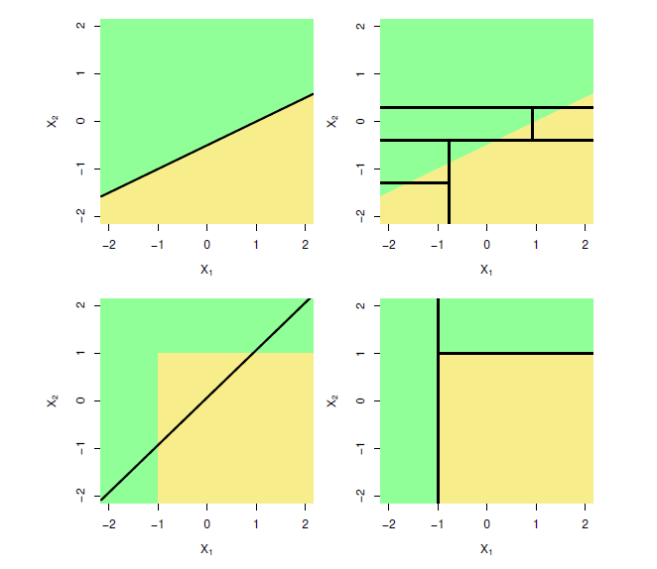
Trees Versus Linear Models
Left column: linear model; Right column: tree-based model
Top Row: True linear boundary
Bottom row: true non-linear boundary.
Notes:
The problem is that we don’t have the luxury to see something like this in high dimension.
• If the relationship between the outcome and the features is approximately linear (or can be transformed accordingly), then linear regression will likely outperform a more complex method, such as a decision tree that does not exploit this linear structure.
• If the relationship appears highly nonlinear and more complex, decision trees will likely outperform the classical models. Keep in mind that the complexity of the relationship needs to be systematic or "real," rather than driven by noise, which leads more complex models to overfit.

Slide 22
Part III
Pruning a tree
Tunning hyper parameters

Slide 23
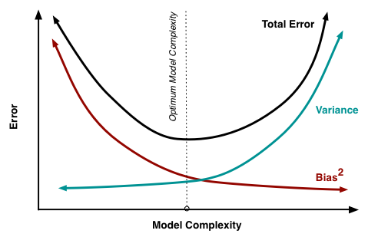
Pruning a tree
A smaller tree with fewer splits may lead to lower variance and better interpretation (but) at the cost of higher bias.
Smaller trees are too short-sighted:
“ a seemingly worthless split early on in the tree might be followed by a very good split, a split that leads to a large reduction in RSS/impurity index later on”
A better strategy is to grow a very large tree, this may produce good predictions on the training set, but is likely to overfit the data, leading to poor test set performance.
So, we need to prune it back in order to obtain a subtree.
Cost complexity pruning is used to do this.
Notes:
Answer to why? Because we can have a so large tree that each observation has its own terminal node, then the training error is 0. so very bushy trees have high variance but low bias.
Pruning is a technique used to deal with overfitting, that reduces the size of DTs by removing sections of the Tree that provide little predictive or classification power.
The goal of this procedure is to reduce complexity and gain better accuracy by reducing the effects of overfitting and removing sections of the DT that may be based on noisy or erroneous data.
Cost complexity = penalizing complex model = penalizing bushy trees. Any idea how can we do that? For example for regression trees?
Tree pruning, in contrast, starts by growing a very large tree before removing or pruning nodes to reduce the large tree to a less complex and overfit subtree. Cost-complexitypruning generates a sequence of subtrees by adding a penalty for adding leaf nodes to the tree model and a regularization parameter, similar to the lasso and ridge linear-regression models, that modulates the impact of the penalty. Applied to the large tree, an increasing penalty will automatically produce a sequence of subtrees. Cross-validation of the regularization parameter can be used to identify the optimal, pruned subtree

Slide 24
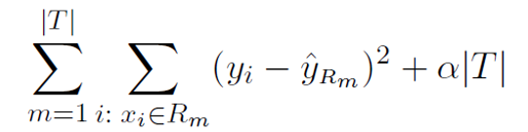
Cost complexity pruning (weakest link pruning)
Consider a sequence of trees indexed by a nonnegative tuning parameter $α.$
For each value of $α$ there corresponds a subtree $T⊂T_{0}$ such that the following objective function is minimized.
$|T|$ indicates the number of terminal nodes of the tree $T$
$R_{m}$ is the rectangle corresponding to $m^{th}$terminal node and
${\hat{y}}_{Rm}$ is the mean of the training observations in $R_{m}$
$α$ controls the bias variance trade off and is determined by cross validation.
Lastly, we return to full data set and obtain the subtree corresponding to $α$
Notes:
If alpha is small, the tree is complex and overfit the training data set. (less bias and less efficient)
If alpha is big, we are penalizing bigger trees which will lead to smaller tree (more biased, more efficient thought)
Alpha determines the number of terminal nodes.

Slide 25

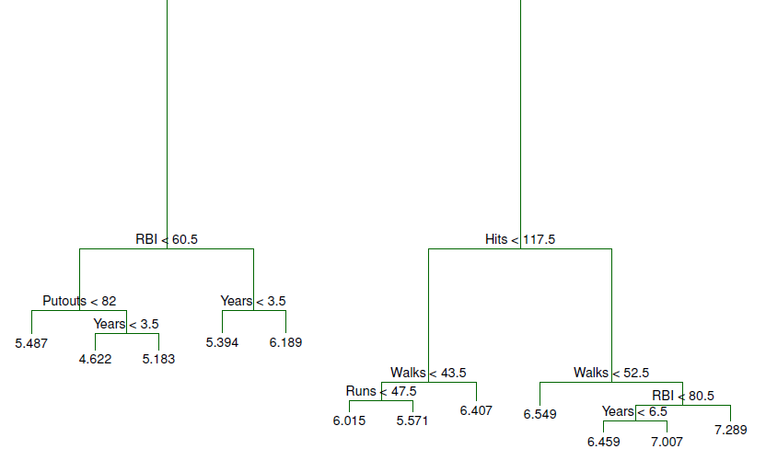
Salary example continued
The unpruned tree that results from recursive binary splitting on the training data
Notes:
Remember our first try was 3 terminal nodes.
Here we have 12 terminal nodes. (We stopped by saying the each node should not contain less than 10 observations for example)
A fielder is credited with a putout when he is the fielder who physically records the act of completing an out -- whether it be by stepping on the base for a forceout, tagging a runner, catching a batted ball, or catching a third strike.
RBI: Runs Batted In

Slide 26
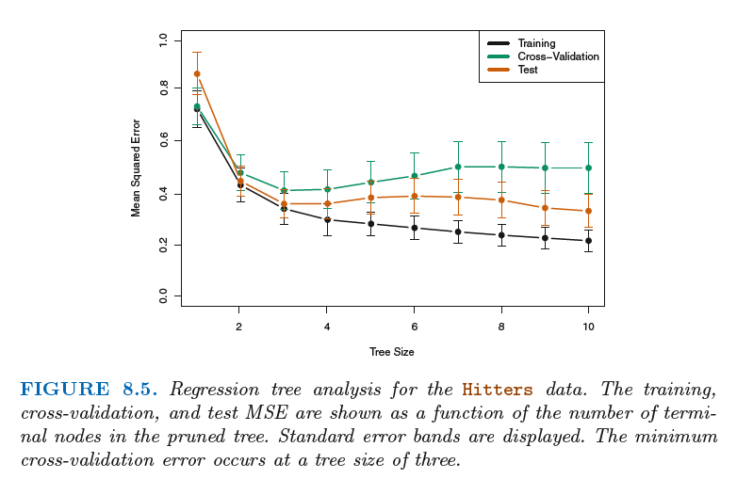
Finding the optimal 𝛼 or T
Notes:
The CV error is a reasonable approximation of the test error
Although CV error is computed as a function of α, it is convenient to display the result as a function of |T|, the number of leaves; this is based on the relationship between α and |T| in the original tree grown to all the training data.

Slide 27
The optimal (pruned) tree
Notes:
Haha, this is the same as our first guess ☺

Slide 28
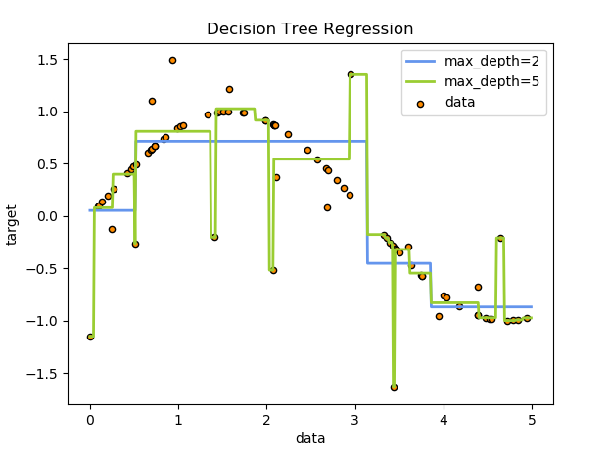
Other hyperparameters
To avoid overfitting, regularization parameters can be added to the model such as:
Maximum depth of the tree
Minimum population at a node
Maximum number of decision nodes
Minimum impurity decrease (info gain)
Alpha (complexity parameter)
Other hyperparameters are:
Criterion: gini, entropy
Splitter: best, random
Class weight: balanced, none
Notes:
Draw depth 2 on the board.
Complexity parameter used for Minimal Cost-Complexity Pruning. The subtree with the largest cost complexity that is smaller than ccp_alpha will be chosen. By default, no pruning is performed.
The “balanced” mode uses the values of y to automatically adjust weights inversely proportional to class frequencies in the input data as n_samples / (n_classes * np.bincount(y))

Slide 29
Part IV
Pros and Cons
Applications in finance

Slide 30
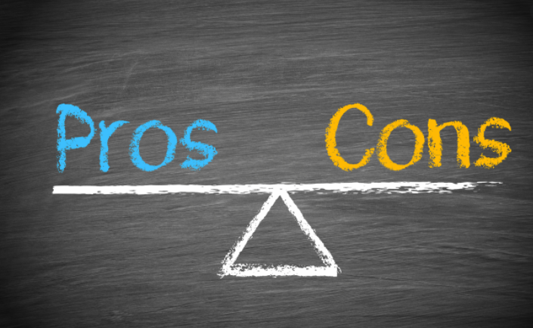
DTs’ Pros and Cons
Pros:
Easy to interpret and visualize
Can easily handle categorical data without the need to create dummy variables
Can easily capture Non-linear patterns
Can handle data in its raw form (no preprocessing needed). Why?
Has no assumptions about distribution because of the non-parametric nature of the algorithm
Cons:
Poor level of predictive accuracy.
Sensitive to noisy data. It can overfit noisy data. Small variations in data can result in the different decision tree*.
*This can be reduced by bagging and boosting algorithms.
Notes:
Each variable can apprears multiple times down the tree. This captures non linearity.
However, by aggregating many decision trees, the predictive performance of trees can be substantially improved. We introduce these concepts next. Ensemble methods (bagging, random forest and boosting). Best ML algos out there not interpretable though.
+ Decision trees are also referred to as white-box models, given the high degree of transparency about how they arrive at a prediction. Black-box models, such as ensembles and neural networks, may deliver better prediction accuracy, but the decision logic is often much more challenging to understand and interpret.
-Decision trees are also sensitive to unbalanced class weights and may produce biased trees. One option is to oversample the underrepresented classes or undersample the more frequent class. It is typically better, though, to use class weights and directly adjust the objective function.
-The greedy approach to decision-tree learning optimizes local criteria that reduce the prediction error at the current node and do not guarantee a globally optimal outcome. Again, ensembles consisting of randomized trees help to mitigate this problem.

Slide 31

DTs’ Applications in finance
Enhancing detection of fraud in financial statements,
Generating consistent decision processes in equity and fixed-income selection
Simplifying communication of investment strategies to clients.
Portfolio allocation problems.
Notes:
Draw a decision tree on the board: age, risk tolerance, liquidity needs, etc.

Slide 32
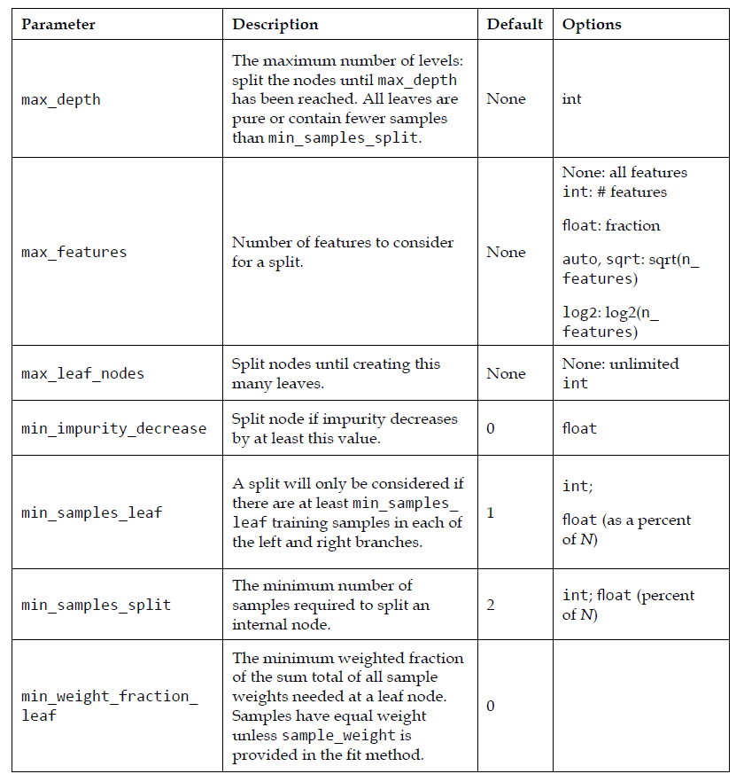
Appendix A
Scikit-Learn decision tree parameters.

Slide 33
Class Modules
Module 1- Introduction to Deep Learning
Module 2- Setting up Machine Learning Environment
Module 3- Linear Regression (Econometrics approach)
Module 4- Machine Learning Fundamentals
Module 5- Linear Regression (Machine Learning approach)
Module 6- Penalized Regression (Ridge, LASSO, Elastic Net)
Module 7- Logistic Regression
Module 8- K-Nearest Neighbors (KNN)
Module 9- Classification and Regression Trees (CART)
Module 10- Bagging and Boosting
Module 11- Dimensionality Reduction (PCA)
Module 12- Clustering (KMeans – Hierarchical)

